Slide 1
Frigid Studios Presents:

Slide 2
A Game Concept by Karl Pytte

Slide 3
Accountants Creed [Temporary Title]
A turn-based medieval business simulator designed to teach Accounting and Finance
Notes:
Accountants Creed drops High School Students into a medieval world of danger, excitement and economics. Players follow a group of travellers as they find riches, trade goods, and save helpless businesses from almost certain insolvency. Along the way players will learn the fundamentals of the Australian tax system, small business management, along with macro & micro economics.
Learn finance, fight bandits, save the world.

Slide 4
Key Features
A robust and transparent medieval economy
A quest-based accounting RPG system
Text-based battle scenarios
Intricate trade system reliant on player choice

Slide 5
Australian Economic Ignorance
Notes:
https://www.ato.gov.au/About-ATO/Research-and-statistics/In-detail/Tax-statistics/Taxation-statistics-2013-14/?page=4#Individuals_summary_tables_and_charts

Slide 6
Australian Economic Ignorance
The Australian Public is experiencing a “shockingly bad state of financial literacy” (Creighton, 2003)
Identifies 3 potential causes:
Declining knowledge
Economic fallacies
A need for education
Notes:
Declining knowledge – a severe decrease in the percentage of the population, both the general public and those in power, who understand economics.
Economic fallacies – faulty reasoning used by the public to interpret financial situations, eg. The broken window & money illusion fallacies.
Need for education
http://www.charteredaccountants.com.au/News-Media/Charter/Charter-articles/Economy/2013-04-Economic-ignorance.aspxon – there is a lack of economic theory and basic accounting being taught in schools across Australia.

Slide 7

Accounting Game Examples
Quiz Games (Bank On It)
Pros:
Recognized by Chartered Accountants
Contains 1000+ questions
Online component
Easy to learn & free
Cons:
Shallow mechanics
Community-driven
Quiz > game
Notes:
http://www.startheregoplaces.com/students/games-tools/bank-on-it/

Slide 8
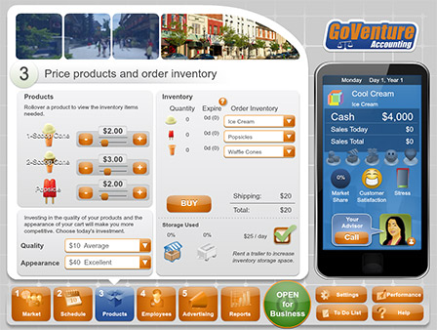
Accounting Game Examples
Simulation Games (GoVenture)
Pros:
User friendly & Immersive
Broad range of concepts
Proven effectiveness
Cons:
Cost Barrier
Information overload
Notes:
http://goventure.net/products/accounting.html

Slide 9
Accounting Game Examples
Simulation Games (GoVenture)
2014 study – 21% increase in grade-point average (GPA) when simulation was assigned
Notes:
http://www.aabri.com/manuscripts/131719.pdf

Slide 10
How is this game different?
Current accounting games | Accountants Creed
Game is a vehicle for the presentation of accounting knowledge | Accounting is seamlessly integrated into the game system
All games are presented in a current-world setting | Medieval flair makes mundane concepts seem novel
Lack of story or narrative | Follow two main protagonists
Low sense of attachment to the game world | Game world encourages players to care by creating meaning through gameplay
No swords | Swords

Slide 11
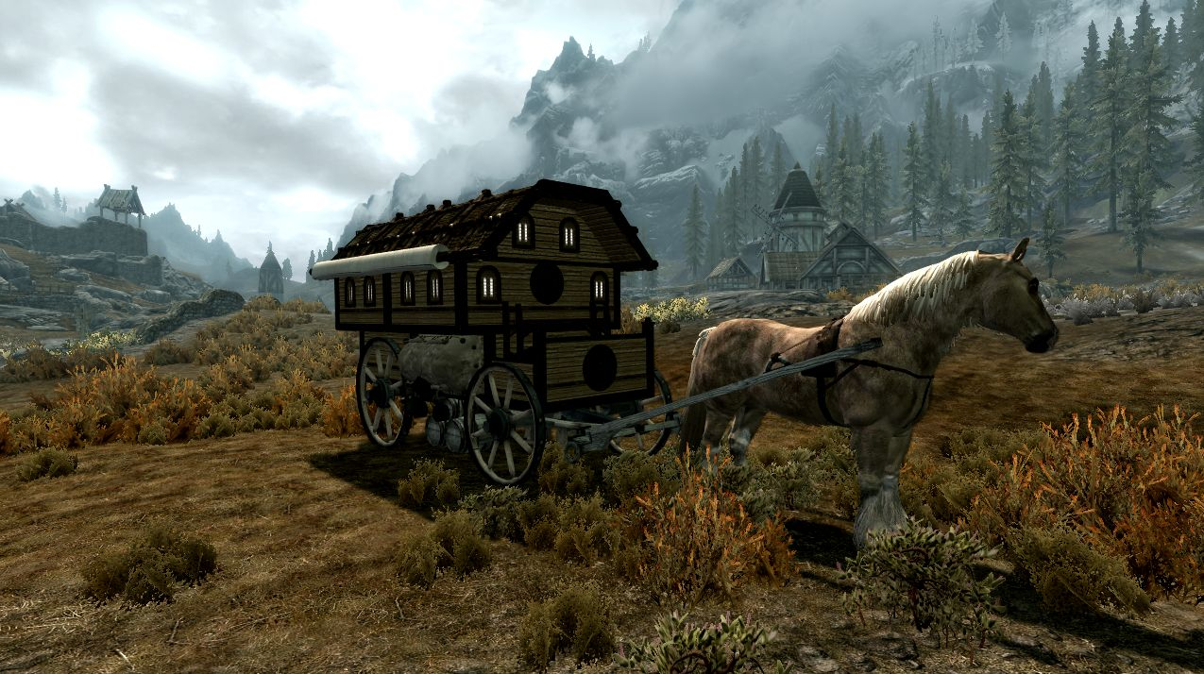
Premise
Game takes place during a time of economic enlightenment
Follows the story of two protagonists:
A travelling merchant gifted in swordplay
A member of an ancient order of economic advisors
Both can gain income and level up in their respective guilds
Notes:
https://staticdelivery.nexusmods.com/mods/110/images/33219-1-1363130172.jpg

Slide 12
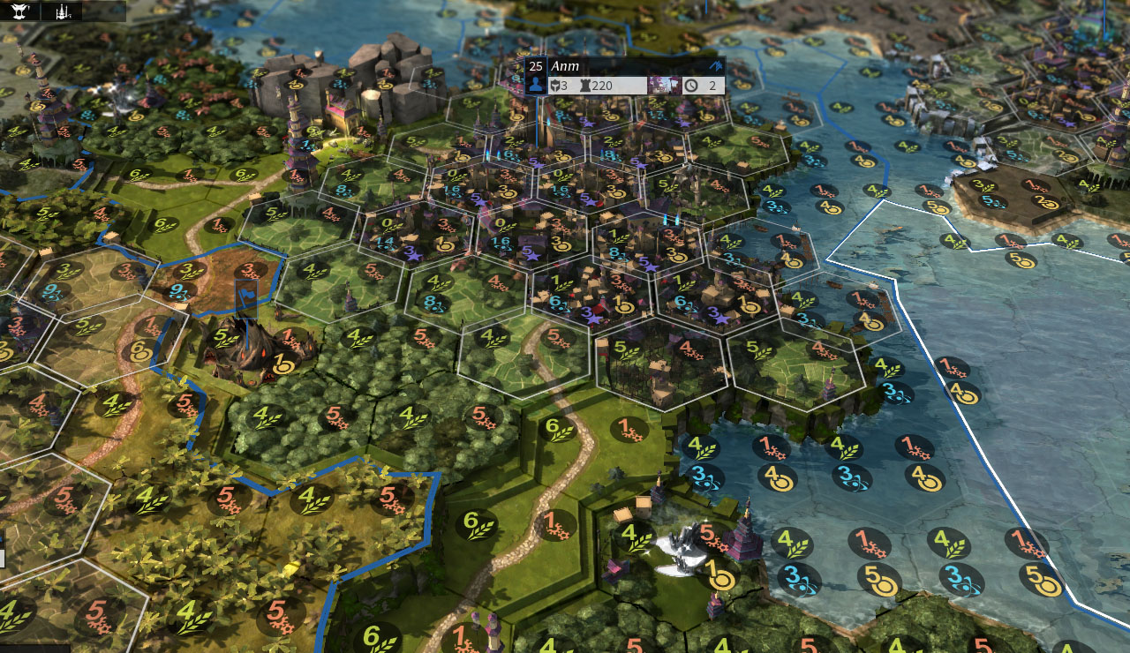
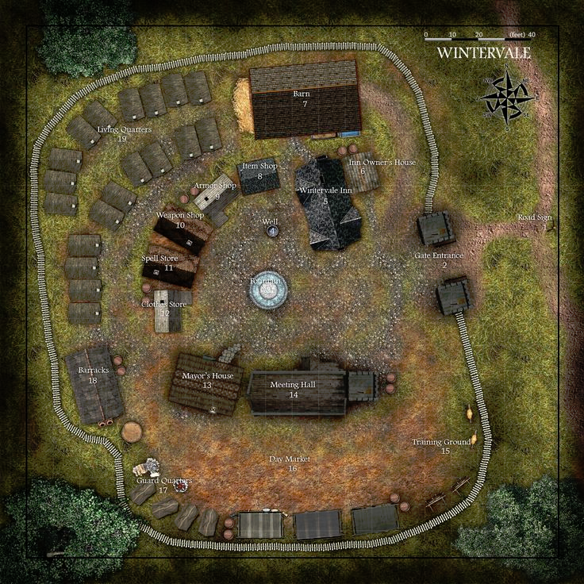
Gamespace
World map
Explore the world and stake a claim
Trade between cities
Hunt bandits or wolves for bounties
Towns
Buy and sell inventory or weapons
Complete accounting quests
Observe Economic transparency
Notes:
https://s-media-cache-ak0.pinimg.com/736x/d8/83/47/d88347856dd87a692bd0471695c476bd.jpg
http://cdn.gameplayinside.com/wp-content/uploads/2014/11/endless-legend-fidsi-example.jpg

Slide 13
Mechanics & Rules
Trade & Exploration
Use gold to purchase goods and trade them between cities.
Goods available determined by reputation with towns and the merchants Guild.
Manage taxes to avoid legal trouble. (General Journal, General Ledger)
Learning outcome: Economics & Tax
Notes:
http://medieval-swords.com/images/parchment-bgd.png
http://www.wordstemplates.org/wp-content/uploads/2012/09/Profit-and-Loss-Statement-Template.jpg

Slide 14
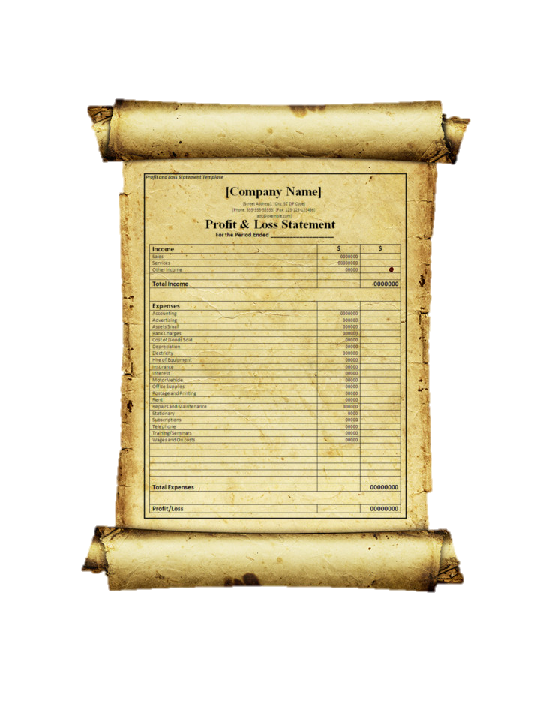
Mechanics & Rules
Accounting Quests
Players will see available quests upon entering towns, with 3 levels of difficulty.
Level 1 – Basic accounting concepts, eg. Assets, Liability & Equity, types of businesses
Level 2 – Financial equations, eg. Assets = Liabilities + Equity
Level3 – Preparation of financial Statements, eg. Balance sheet, Profit & Loss statement (Desirable)
There will be rewards for success, and penalties for failure.
Learning Outcomes: Basic to Advanced Accounting
Notes:
http://medieval-swords.com/images/parchment-bgd.png
http://www.wordstemplates.org/wp-content/uploads/2012/09/Profit-and-Loss-Statement-Template.jpg

Slide 15
Mechanics & Rules
Combat Encounters
Can happen every turn when traversing the world map
Combat is a simple battle readout that computes how well the caravan was defended.
Can be reinforced with better weapons & mercenaries.
Defeating enemies earns bounty, redeemed in towns.
Learning outcome: risk management.
Notes:
http://www.hiveworkshop.com/attachments/screenshot4-jpg.114322/

Slide 16
Win & lose States
Victory
Reach 100+ reputation
Pay off debts
(Desirable)
Complete Merchants Story
Pay off debt & grow business
Complete Accountants Story
Reach highest level in the order.
Complete final quest.
Defeat
Reach negative balance
Reach -100 reputation
No combat defeat

Slide 17
Out of Scope
Advanced accounting
Nation specific financial rules & international trade
Character RPG mechanics
Primary NPC characters

Slide 18
Technical Details
Software Type | Name
Game Engine | Unity 5.3
Modeling Software | 3ds Max
Textures | Photoshop, Quixel Suite
Version Control | Github
Scheduling | Trello
Team Communication | Slack

Slide 19
Technical Details
Major Stakeholder – West Australian Department of Education
Publishing
Unity Webplayer
Digital Download PC & Mac
Physical Copy
Mobile & Tablet (Desirable)
Target Market
High School Teachers
High School Students
College Students
Home Users

Slide 20
Budgeting
Task | Amount
Unity pro subscription | $75/month ($225)
3dsMax | $286/month ($858)
Photoshop | $57/month ($171)
Quixel | $79
Salary | Negotiable
Total | $1,333

Slide 21
Thank you for listening

